Slide 1



Mini modelling
G.H. Raisoni College of Engineering and Management , Pune
Group B3

Slide 2
Team members : TCOA36: Dhiraj Khole TCOA37: Komal Gaikwad TCOA51: Sukanya Pawal TCOA54: Sakshi
Department: computer science
Class: TYA

Slide 3

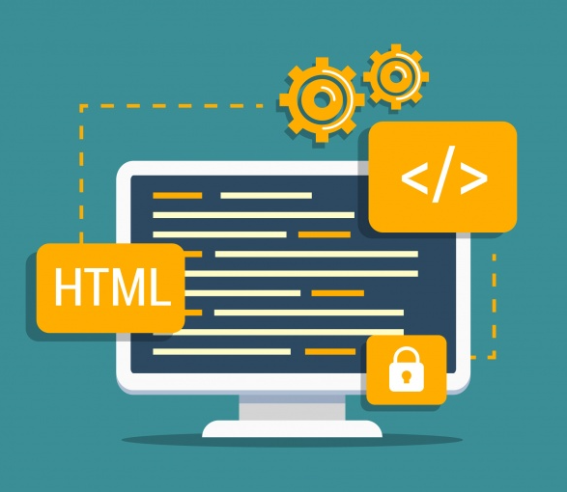

Topic:
To create a website for covid-19 test slot booking along with a chatbot.

Slide 4

Content
1.
The idea behind this project.
2.
Modules and Design of the website
3.
Features of the chatbot
4.
Software and Hardware Requirements
5.
Future Scope

Slide 5

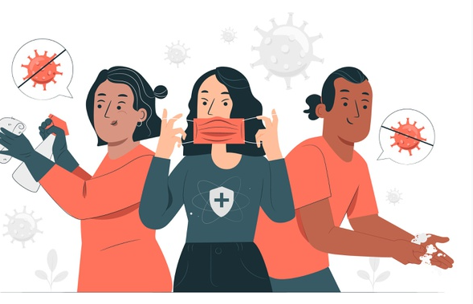
The idea behind this project:
Growing number of COVID-19 cases and the lack of services.
An online system for booking test slots will support hassel free testing and will save a lot of time.
To provide the viewers with testing centres available at their nearest distance and book a slot for them online.

Slide 6

The main focus :
Build a website which provides full awareness about the pandemic and allow users to search for the nearest testing Centre available in their city and book a test slot according to their convenience with the help of a Chatbot if they wish to get themselves tested.

Slide 7

Modules and Design:
The website would be a dynamic website with easy navigation system.
A total of 5 modules are their with a Chatbot.
There is also a very special module which would allow people to donate to authorized bodies which are helping people to survive in this pandemic.
It’s interface would be designed to work on both mobile and Pc.

Slide 8

Modules
1
Home Page/info:
Would give the general info about our website and help viewers navigate through our website.
2
Latest info :
would contain all the latest news and article related pandemic.
3
Test Centers and their location via google maps.
4
Donations Page:
Would allow users to search for NGO’s and donate.
5
About us Page:
Would contain the details about our work.

Slide 9
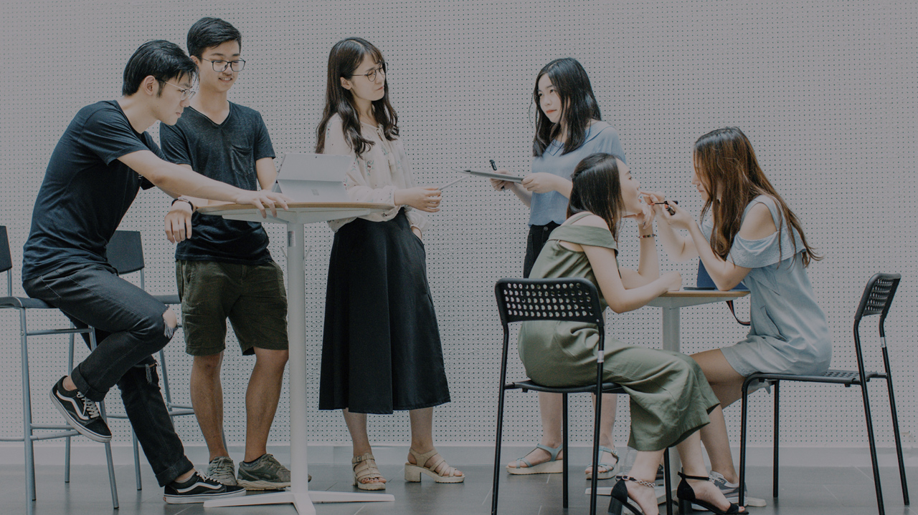
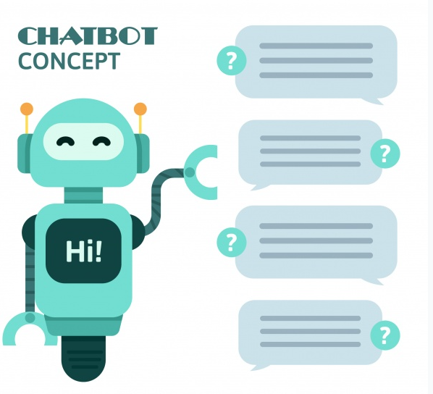
Features of the chatbot:
If you are willing to book a test slot, you will be guided by the chatbot after entering basic information you will be asked to enter your pin code(only for live data) and based on that your nearest test center will be shown to you and you will be provided by a form..
Once you filled the form your confirmation will be done by the test center and you can now pay the fees and lock your slot or if you wish you can delete or choose another timing.
Change of slot is allowed twice every 24 hrs.

Slide 10

Hardware requirements
The basic hardware requirement would be a laptop or a desktop with an operating system.

Slide 11
Software Requirements: visual studio and sublime text.
HTML 5
to create​ static pages on web browser.
CSS
For the presentation of Web page, including colours, layout, and fonts
Bootstraps
As CSS framework to simplify our layout.
JavaScript
For designing forms and using validation.
Python
For designing the Chatbot

Slide 12

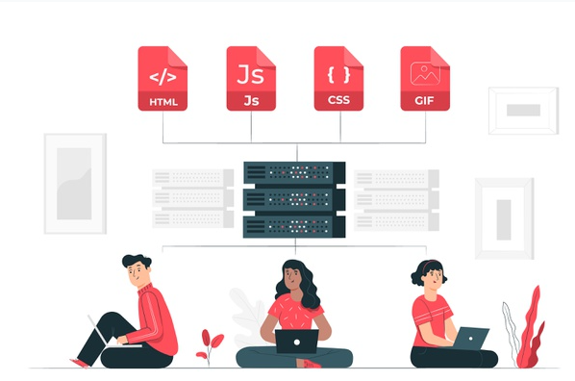
SERVER
XAMPP: Since we are not hosting our website online, we will be using XAMPP as a web server solution to link our database on local host.

Slide 13

Database
MYSQL : It would be maintaining the record of the tests booked, And donations made (if any) on daily basis.

Slide 14
Future Scope:
1.
Once the vaccines are out this will help govt. to distribute them effectively and efficiently.
2.
It can become a general appointment booking system.
3.
With live data it can help people to find nearest help available in case of any fatality.
4.
Donations can go on forever and Grow.
5.
Can become a website with all latest information about healthcare and lifestyle.

Slide 15
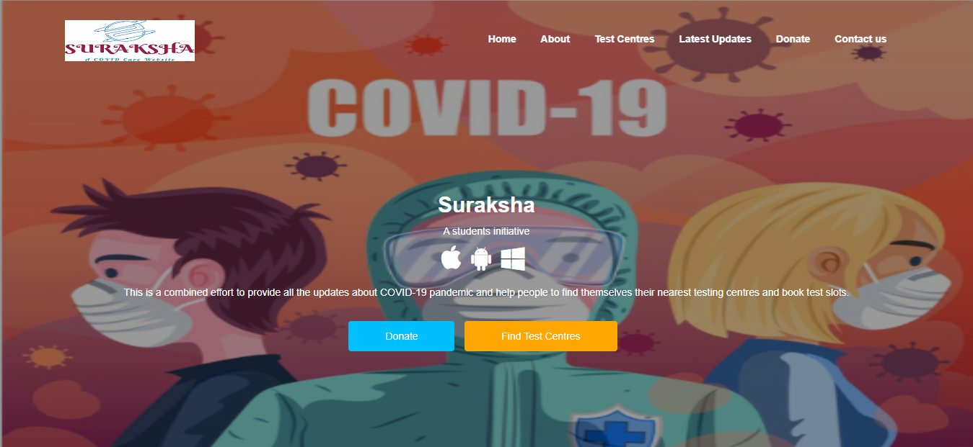

Slide 16
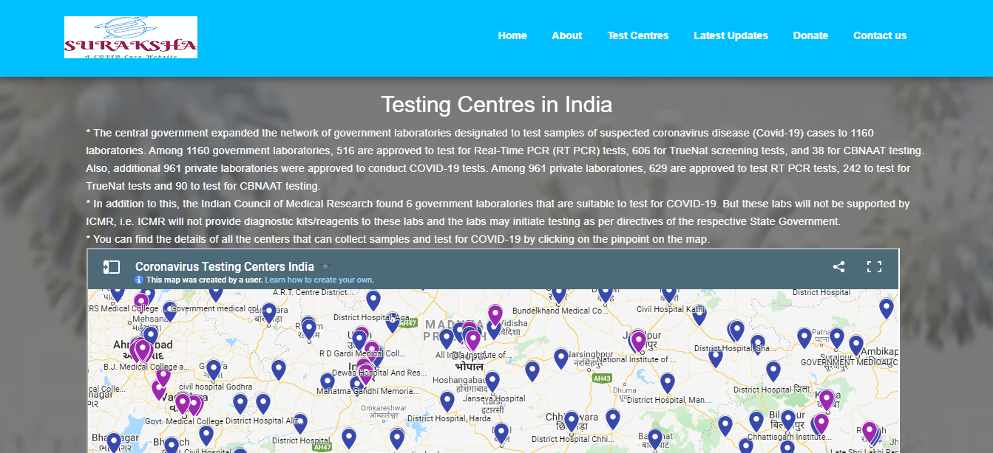

Slide 17
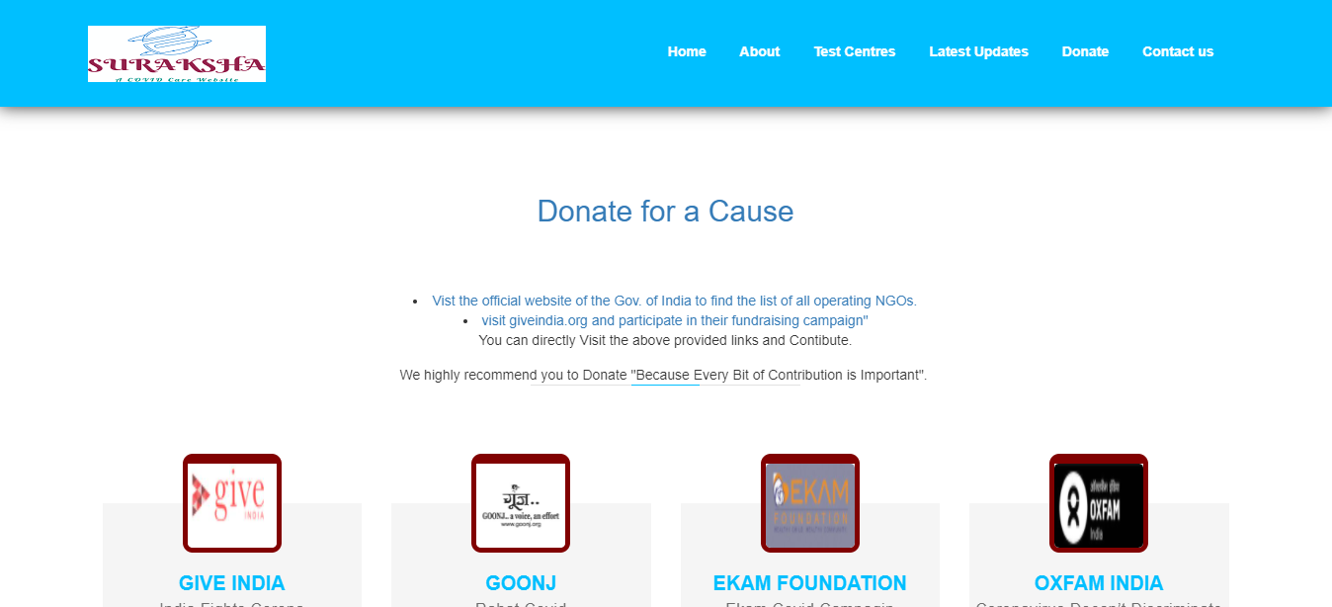

Slide 18
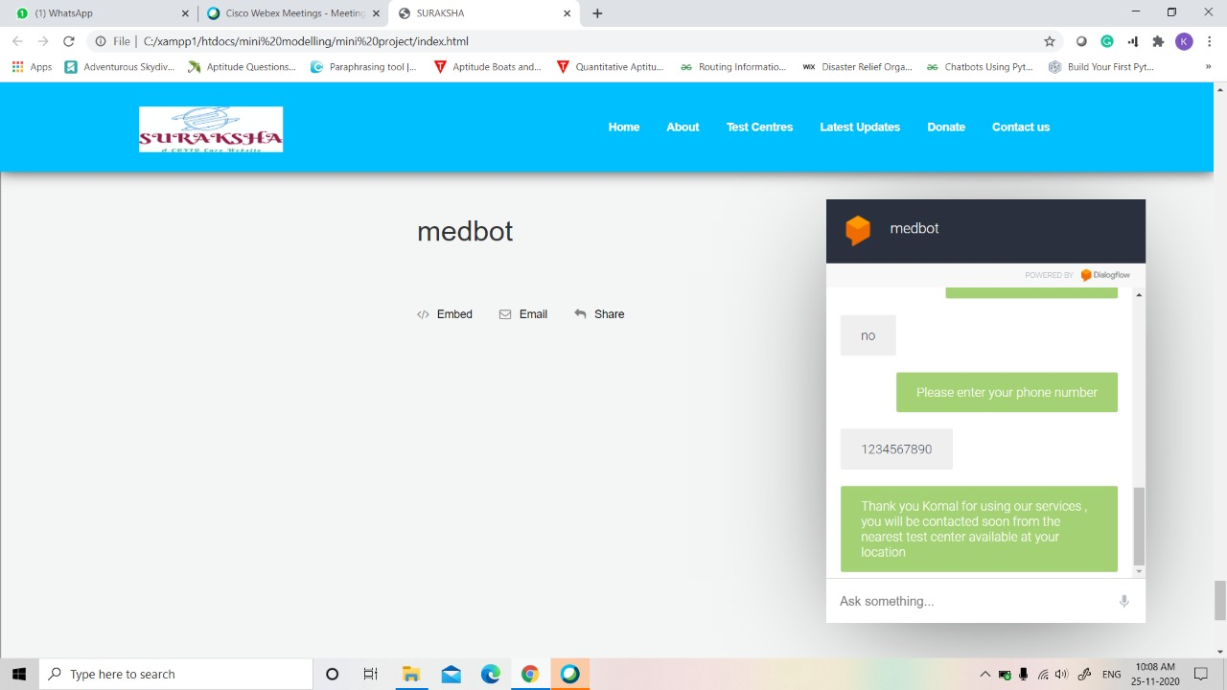

Slide 19

Thank You!
For your kind attention

